Slide 1
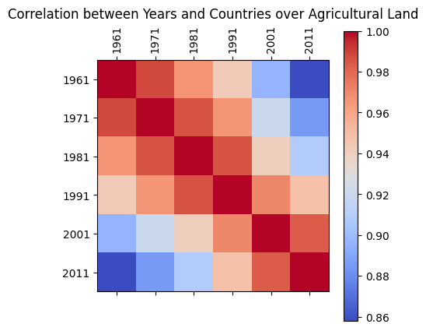
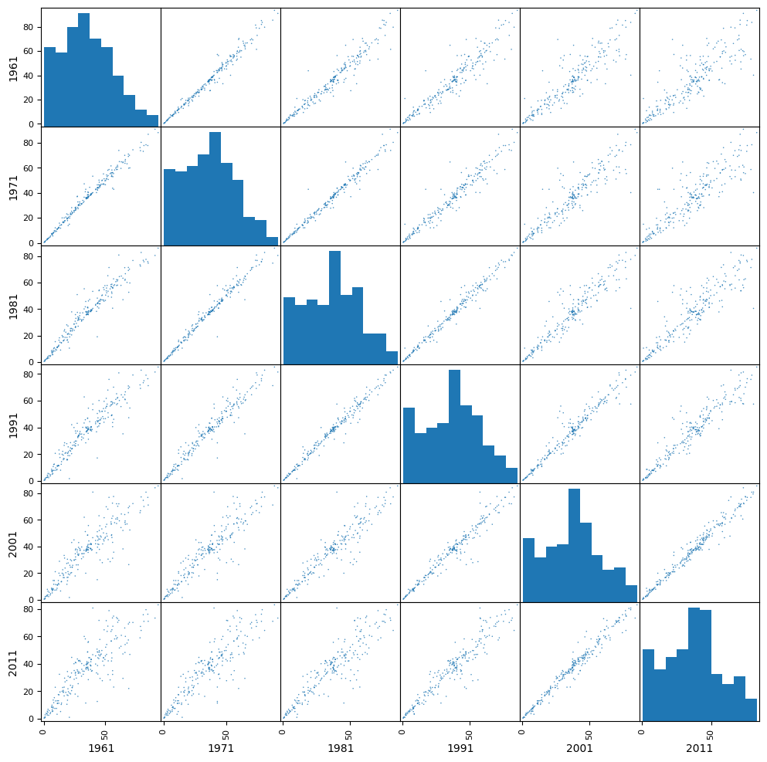
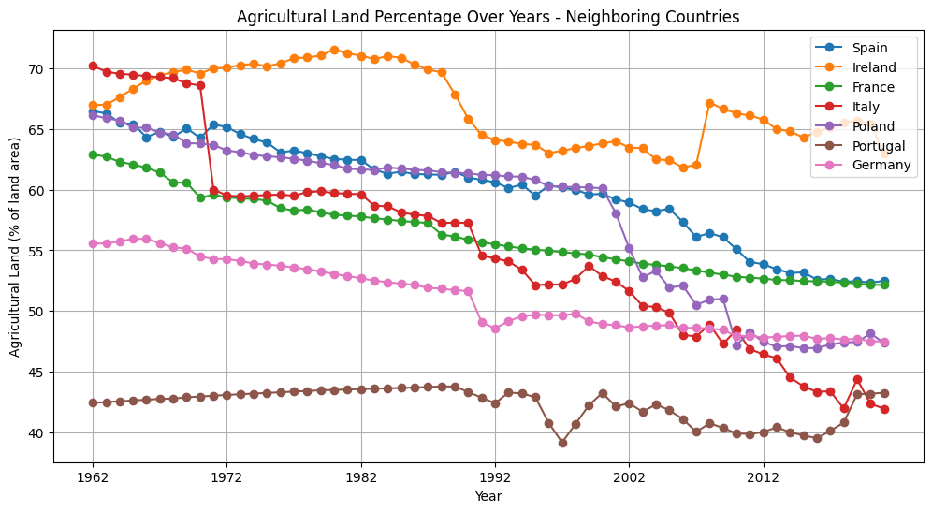
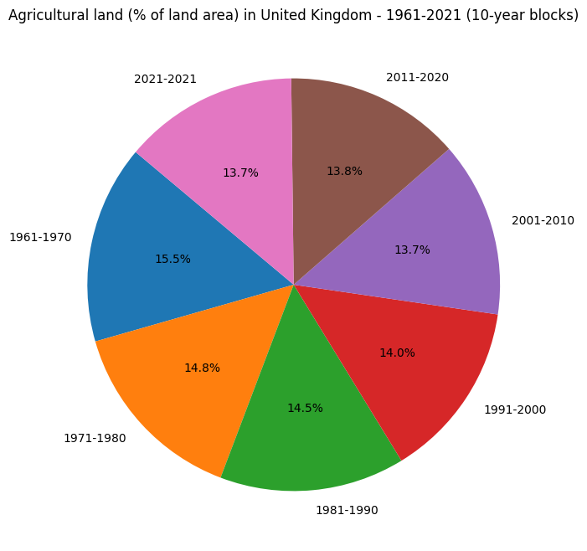
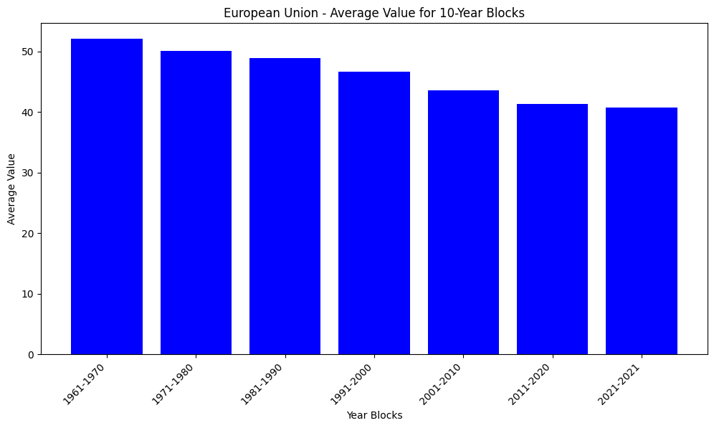
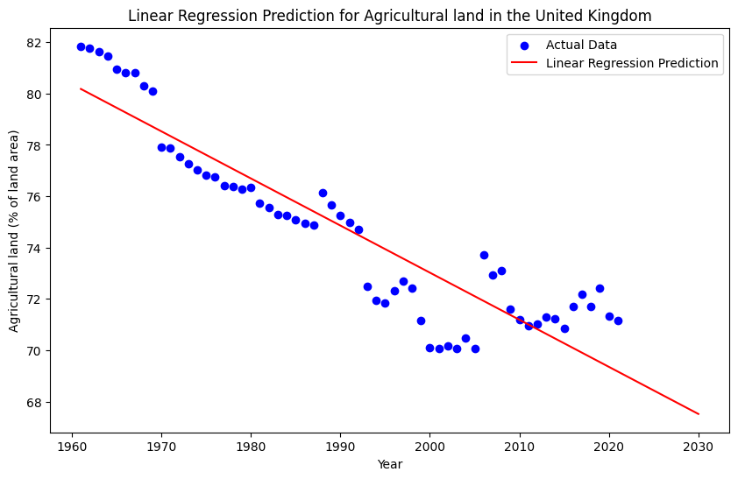
Analysis of Agricultural Land
Student Name: Geetha Bonthu
Student ID: 22095828
Abstract
A correlation has been found between the Agricultural industry and available land across the European countries. It has been learned that agricultural land in European countries have been consistently decreasing with respect to increasing number of years. By the year 2012, the available land for agriculture remains expectedly less than what was used earlier few decades ago in these nations.
Introduction
The agricultural industry generates huge amount of revenue in European countries and supports its economy. However, the industrialization of other sectors reduces the availability of land in this continent making it difficult for corresponding government to sustain the production. The purpose of this study is to explore the changing scenario of agricultural land of European continent so that an insight can be gained regarding the subject.
Agricultural Land availability by Increasing Years-Correlation
Various peaks can be seen in the boxes of above diagram corresponding to the years 1961, 1971, 1981,1991, 2001 and 2011. A correlational parameters are always checked between 1 and -1 and therefore, a one side of density of peak across the boxes is more than other side. The inclination of correlation is toward positive value with lower values of years justifying less available land.
Correlation between Years and Agricultural Land
It can be understand from the visualization of correlation between European countries and years that agricultural land is found to be decreasing in the gap of 10 years starting from the year 1961. After processing this first visual, the correlational outcome mentioned in the second picture as its outcome.
Agricultural Land Percentage of Neighboring Countries
The multiple linear visuals have been developed for the neighboring countries of United Kingdom. Spain, Italy, France are those countries where agricultural land have been consistently decreased from 1961 to 2012. Ireland had improved during the period from 1962 till 1980 after that it exhibited decline. Likewise, Portugal’s agricultural land’s availability were little higher till 1989 but after that an abrupt fall has been noticed in land availability.
Agricultural Land in United Kingdom
The pie-chart mentioned above shed lights on the available agricultural land in United Kingdom in different slots of decades. For example, the available land for agriculture was 15.5% during the decade 1961-1970. Likewise, these percentages are revealed till the period 2011-2020. In addition, it has been observed that percentage range remain between 15.5% and 13.7% across every slot of decade.
European Union-Average value for 10-Year Blocks
From the columnar graph, it become clear that the nations from European Union losing its agricultural land with respect to increasing blocks of decades. This visualization gives idea about an average value that can be considered as generic opinion for all EU nations collectively.
Prediction of Agricultural Land in UK
Linear regression technique has been implemented over the data values of UK to showcase the availability of agricultural land by the year 2030 in future.
Conclusion
Based-on the multiple visualizations, it has been concluded that the availability of agricultural land is decreasing with increasing years. It is a fact that all countries of Europe does not exhibited similar change in the occupancy of agricultural land but the final outcome are more or less same. The effectiveness of governmental administration has been learned from nations like Ireland and Portugal for the period between 1970 to 1980 in terms of handling agricultural lands.
Source: https://github.com/Geethabonthu/Owner-avatar-Applied-Data-Science-Assignment3

